Slide 1

Introduction to Computer Software Timers
Professor : Jake Tarn
Lecturer: Sunny

Slide 2
Software Timer Callback
ATimerCallback()
void ATimerCallback ( TimerHandle_t xTimer );
Notice
1. Must not contain infinite loops like the tasks, they have to exit in a normal way.
2. Should be kept very short and must not enter into phase like the blocked state or wait on other resources.

Slide 3
Types of Software Timers
One – shot
Executes only one
Cannot restart itself
Auto – reload Timers
Executes periodically
Restart itself

Slide 4
Software Timer States
Dormant State
Callback function does not execute
Running State
Executes callback function

Slide 5
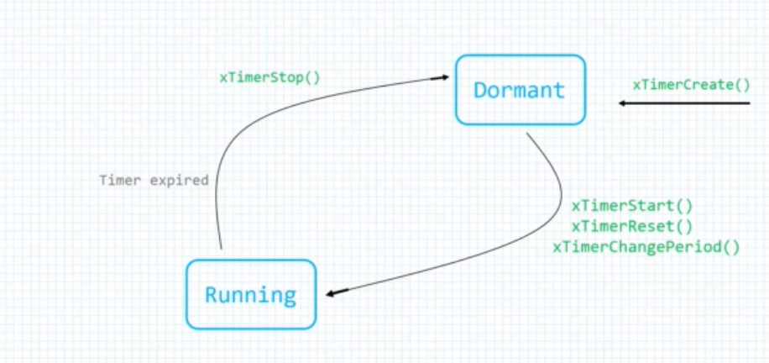
One shot software timer states and transitions

Slide 6
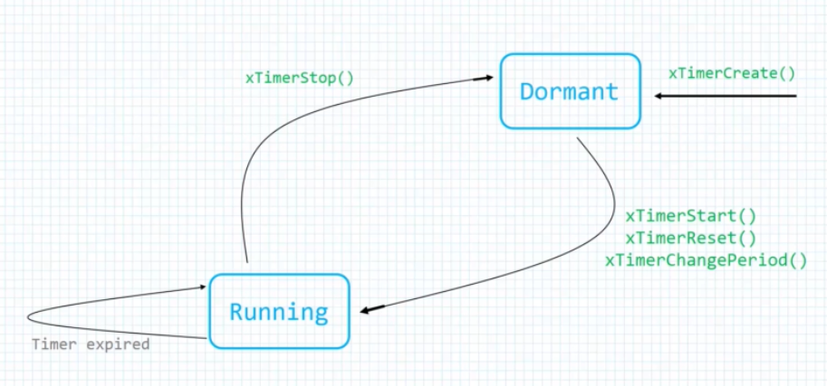
Auto reload software timer states and transitions

Slide 7
Timer management functions
xTimerCreate()
TimerHandle_t xTimerCreate (
const char * const pcTimerName,
TickType_t xTimerPeriodInTicks,
UBaseType_t uxAutoReload ,
void * pvTimerID ,
TimerCallbackFunction_t pxCallbackFunction
);

Slide 8
Timer management functions
xTimerStart()
BaseType_t xTimerStart (
TimerHandle_t xTimer,
TickType_t TicksToWait
);

Slide 9
The Timer ID
void vTimerSetTimerID(
const TimerHandle_t xTimer,
void* pvNewID
);
void* pvTimerGetTimerID( TimerHandle_t xTimer );

Slide 10
Changing the time period
BaseType_t xTimerChangePeriod(
TimerHandle_t xTimer,
TickType_t xNewTimerPeriodInTicks,
TickType_t xTicksToWait
);

Slide 11
Software Timer

Slide 12
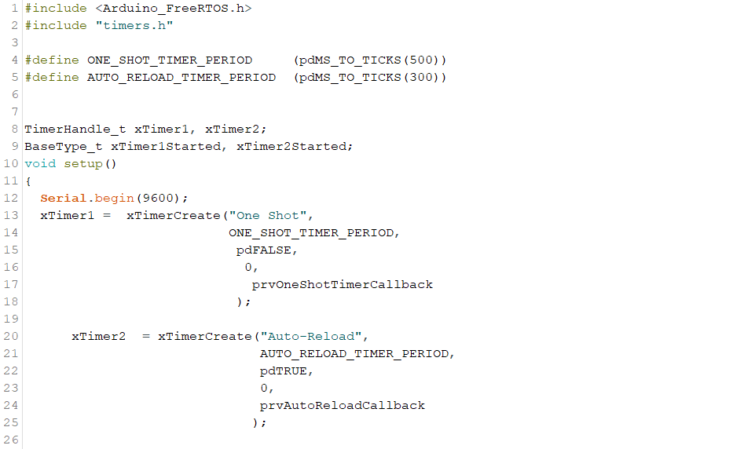

Slide 13
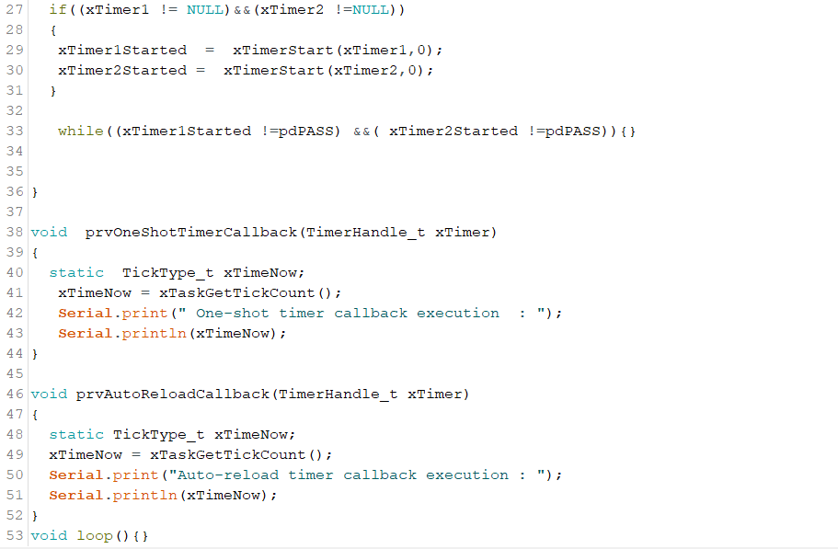

Slide 14
Interacting with software timers

Slide 15
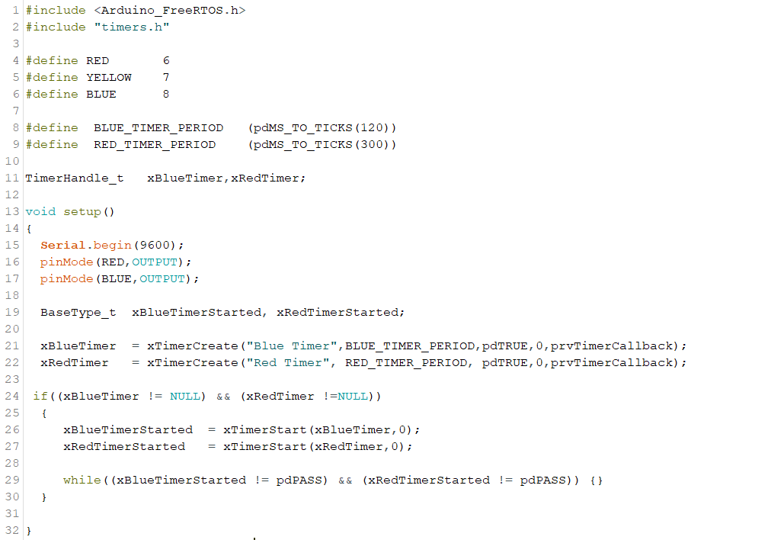

Slide 16
